Slide 1
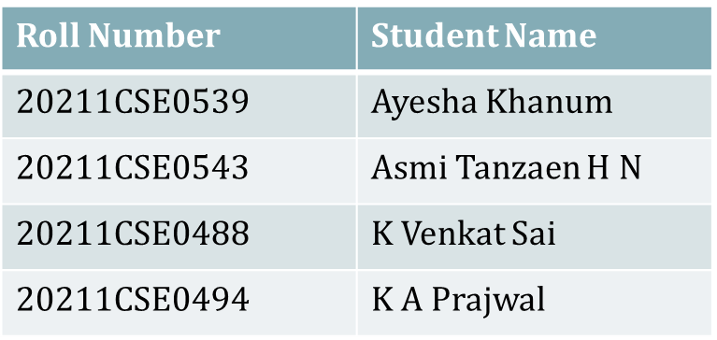
PIP2001 Capstone Project Viva- voce
INTELLISEARCH INTELLIGENT EMPLOYEE DATA ACCESS SYSTEM
Batch Number: CSE-76
Under the Supervision of,
Mr. Amarnath J.L
Assistant Professor
School of Computer Science and Engineering
Presidency University
Name of the Program: B.TECH Computer Science And Engineering
Name of the HoD: Dr. Asif Mohammed H B
Name of the School Project Coordinators: Dr. Abdul Khadar A

Slide 2
1.INTRODUCTION
Project Overview:
Development of an AI-powered chatbot designed for company or institutional use.
Primary function: Efficiently manage employee records and respond to queries in real time using natural language processing (NLP).
Problem Statement:
Traditional employee management systems are labor-intensive, requiring manual lookups, prone to delays, and susceptible to human errors.
Organizations face inefficiencies due to outdated systems, which impacts productivity and information accessibility.

Slide 3
2.Literature Review (Summary of Research Papers)
Design and Development of CHAT-BOT A Review
Summary: This paper explores the various applications of chatbots in different industries, including healthcare, finance, and business automation. It discusses the evolution of chat-bot technology, from rule-based systems to AI-driven conversational agents. The paper highlights the effectiveness of AI chatbots in improving customer service, automating routine tasks, and enhancing user engagement.
Link: https://www.researchgate.net/publication/351228837_Design_and_Development_of_CHATBOT_A_Review
2. Chatbots Development Using Natural Language Processing: A Review
Summary: This review paper focuses on various NLP techniques like tokenization, sentiment analysis, named entity recognition (NER), and machine learning models used to enhance chat-bot performance. It emphasizes the importance of understanding and processing natural language input to deliver accurate and context-aware responses.
Link: https://www.researchgate.net/publication/367369151_Chatbots_Development_Using_Natural_Language_Processing_A_Review

Slide 4
2.Literature Review (Summary of Research Papers) (continued…)
3. Live support by chatbots with artificial intelligence: A future research agenda
Summary: The paper explores methods to integrate AI chatbots with databases, focusing on SQL and NoSQL systems. It explains how chatbots can be designed to retrieve and update information dynamically based on user input. The study also addresses the challenges of maintaining data consistency and security when linking chatbots to employee management systems.
Link : https://www.researchgate.net/publication/365049624_Live_support_by_chatbots_wit_h_artificial_intelligence_A_future_research_agenda
4. Enhancing Employee Productivity Through Technology System AI-Based Approaches
Summary: This research investigates how AI technologies are being applied in modern employee management systems. The paper describes how AI-driven platforms can automate tasks such as attendance tracking, performance evaluation, and employee engagement activities. It also evaluates the effectiveness of AI in enhancing operational efficiency and reducing administrative costs.
Link: https://www.researchgate.net/publication/365049624_Live_support_by_chatbots_with_artificial_intelligence_A_future_research_agenda

Slide 5
2.Literature Review (Summary of Research Papers) (continued…)
5. Conversational Agents: Goals, Technologies, Vision and Challenges
. Summary: This paper delves into the design principles and architecture of conversational agents, specifically focusing on multi-layered structures that include intent recognition, dialogue management, and response generation modules. It also explores the use of pre-trained models like GPT-3 for building more advanced and accurate conversational agents.
Link: https://www.mdpi.com/1424-8220/21/24/8448
6. Security Considerations for AI Chatbots
Summary: This paper discusses the security challenges associated with deploying AI chatbots in enterprise environments. It highlights potential vulnerabilities, such as unauthorized access, data breaches, and privacy concerns, and suggests best practices for securing chat-bot applications using encryption and authentication mechanisms.
Link: https://www.technologyreview.com/2023/04/03/1070893/three-ways-ai- chatbots-are-a-security-disaster/..

Slide 6
2. Literature Review (Summary of Research Papers) (continued…)
7. The Impact of Chatbots on Customer Service Performance
. Summary: This research examines the influence of AI chatbots on employee engagement and productivity in organizations. The paper finds that chatbots help employees access information faster, submit requests more efficiently, and provide instant feedback, leading to an overall increase in employee satisfaction and performance.
. Link: https://www.researchgate.net/publication/342842655_The_Impact_of_Chatbots_on_C ustomer_Service_Performance
8. Machine learning algorithms for teaching AI chat bots
. Summary: This paper explores the various machine learning models that can be used to train AI chatbots, including decision trees, support vector machines (SVMs), and neural networks. It also covers the advantages and disadvantages of each model and recommends the best practices for selecting and implementing these models based on the chat-bot’s intended use case.
. Link: https://www.sciencedirect.com/science/article/pii/S1877050921013417

Slide 7
2.Literature Review (Summary of Research Papers) (continued…)
9. Artificial intelligence for the improvement of records management
Summary: This study focuses on automating employee record management using AI- based solutions. It explains how AI can automate record-keeping tasks like attendance monitoring, leave management, and performance evaluations. The paper also provides insights into integrating AI chatbots to enhance these automated systems by providing a conversational interface for accessing records.
Link: https://www.researchgate.net/publication/365419934_Artificial_intelligence_for_the_improvement_of_records_management_activities_at_the_Council_for_Scientific_and_Industrial_Research
10. A Review of AI-Driven Conversational Chatbots Implementation Methodologies and Challenges
Summary: This paper discusses the scalability and maintenance challenges associated with deploying AI chat-bot systems in large organizations. It suggests methods for scaling AI models and maintaining them effectively by implementing CI/CD pipelines, version control for models, and continuous monitoring.
Link: https://www.mdpi.com/2071-1050/15/5/4012

Slide 8
3. Research Gaps Identified
Rule-Based Systems
Limitations: Only answer predefined queries, unsuitable for complex scenarios.
Scalability: Growth in queries increases system complexity.
2. Machine Learning and NLP Models
Challenges: Integration with custom databases and retaining multi-turn dialogue context.
Security: Managing sensitive data securely is critical.
3 .Hybrid Systems
Maintenance: Requires handling both rule-based and AI models.
Performance: Risk of delays due to heavy computational needs and database integration
4. Custom Data Integration
Custom Data Integration
Database Compatibility: Many frameworks fail with proprietary or custom databases.
Privacy Concerns: Handling personal/financial data requires stringent measures.

Slide 9
3. Research Gaps Identified
5.Contextual Understanding
Complex Conversations: Struggles in maintaining meaningful context in prolonged dialogues.
6. Scalability
High User Load: Systems degrade in performance during peak usage.

Slide 10
Proposed Methodologies
1. Enhanced NLP and Machine Learning Models
Use NLP libraries like NLTK and spaCy for better language understanding.
Implement contextual retention for multi-turn dialogue support.
2. Database Abstraction Layer
Standardizes interaction with SQL/NoSQL/custom databases, reducing complexity.
3.Role-Based Access Control (RBAC)
Assigns data access based on user roles, ensuring security.
4. Advanced Security Protocols
Use encryption (SSL/TLS) and OAuth 2.0 authentication.
Ensure compliance with GDPR and similar regulations.
5. Caching and Parallel Processing
Speeds up data retrieval and response time under heavy user loads.
6. Hybrid Chatbot Design
Integrates rule-based and AI models, switching dynamically as per query complexity.

Slide 11
Objectives
Primary Objective
1. Automation of Employee Information Management
Provide employees access to real-time information through conversational AI.
Streamline processes for updating, retrieving, and managing employee data.
Secondary Objectives
2. Reduce Time and Effort
Eliminate manual processes, enhancing workflow efficiency.
Automate repetitive HR tasks like attendance tracking.
3. Enhance User Experience
Utilize NLP for accurate query interpretation.
Deliver personalized responses based on user-specific data.
4. Improve Security
Protect sensitive employee data through robust security frameworks.
Ensure compliance with data protection laws like GDPR.
5. Scalability and Adaptability
Handle increasing users and query complexities effectively.
Adapt for potential use in industries like healthcare and finance.

Slide 12
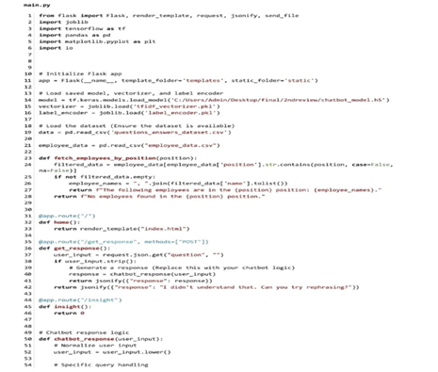
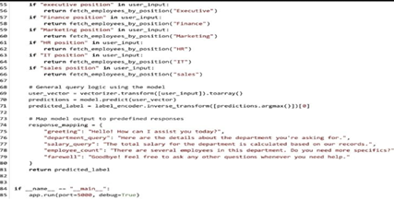
System Design & Implementation

Slide 13
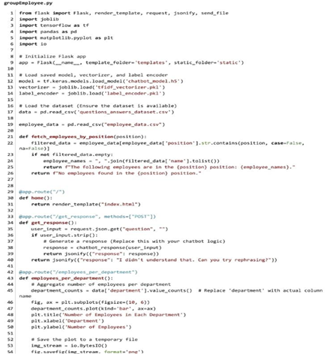
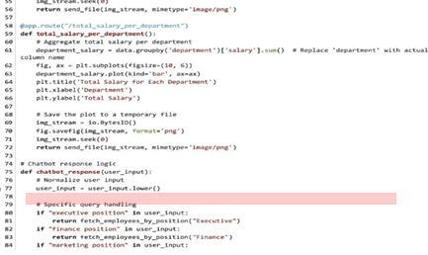
System Design & Implementation

Slide 14
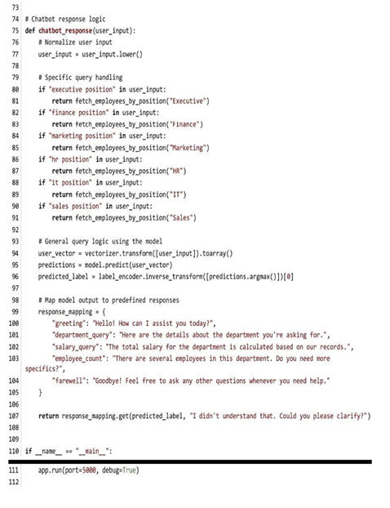
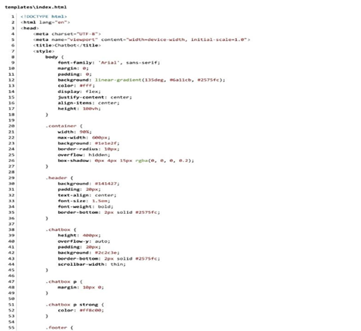

System Design & Implementation

Slide 15
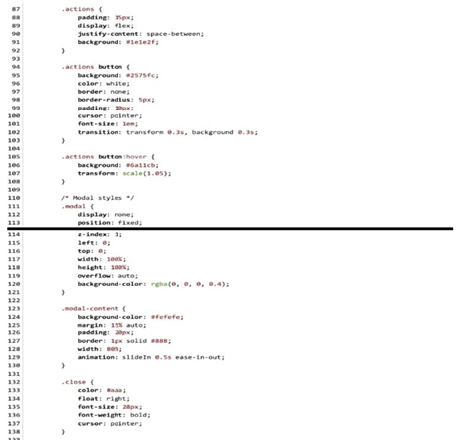
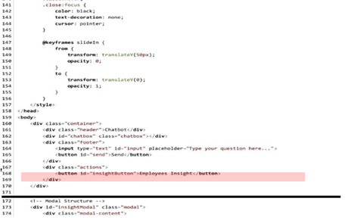
System Design & Implementation

Slide 16
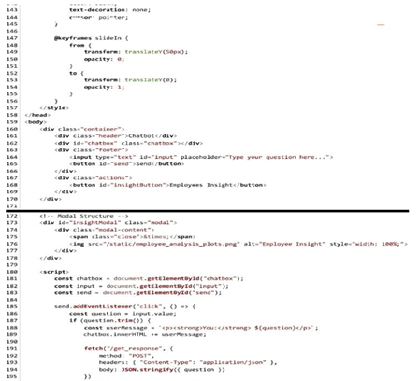
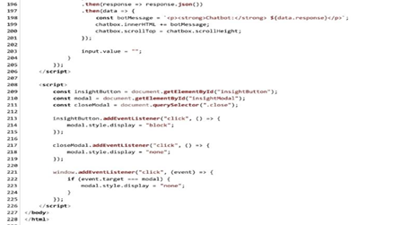
System Design & Implementation

Slide 17
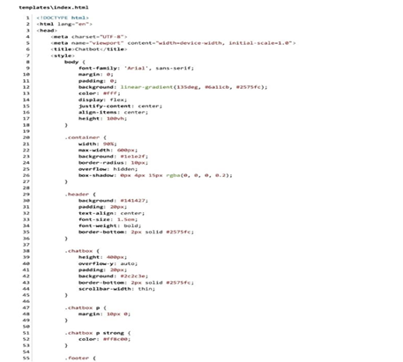

System Design & Implementation

Slide 18
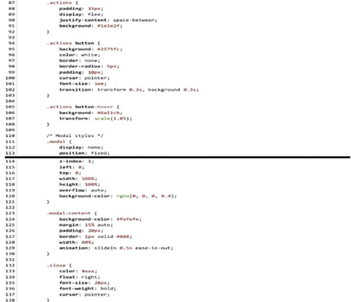
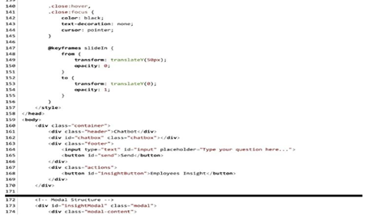
System Design & Implementation

Slide 19
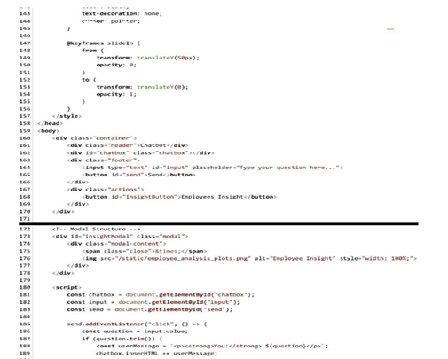
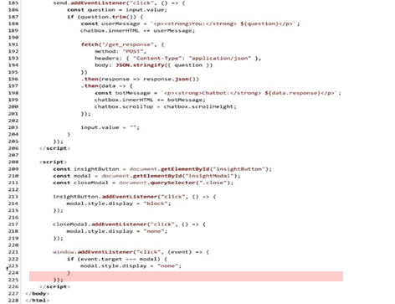
System Design & Implementation

Slide 20
Hardware & Software Components
Hardware Requirements:
Standard computing device (PC/laptop) with enough processing power to run Python scripts and AI models.
Software Components:
Programming Language: Python for backend development.
NLP Libraries: NLTK, spa-Cy for natural language understanding.
AI Framework: Tensor Flow for building and training the neural network model.
Database: CSV for initial data storage (scalable to SQL/NoSQL databases).
Frontend Development: React for creating the chat-bot interface.
Other Tools: Git for version control, Docker for deployment, and authentication mechanisms like OAuth for security.

Slide 21
Timeline of Project
Week 1: Conduct Literature Review, generate datasets, and start with data
preprocessing.
Week 2: Develop the QA dataset and refine the data using NLP techniques.
Week 3: Train and test the chat-bot model using Tensor Flow; implement
improvements based on test results.
Week 4: Design and integrate the frontend UI, ensuring compatibility with the modeland database.
Week 5: Perform integration tests and evaluate chat-bot performance; troubleshoot issues.
Week 6: Final deployment, documentation preparation, and presentation of outcomes.

Slide 22
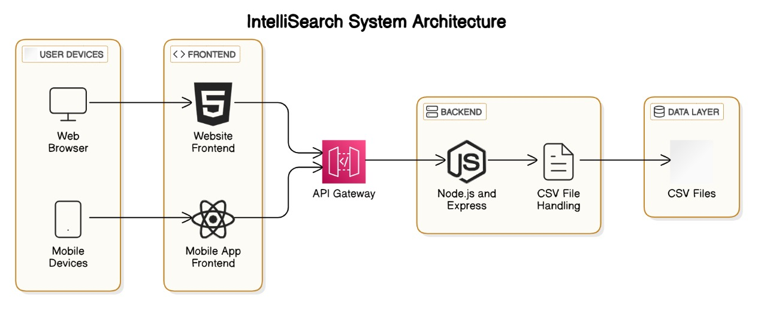
Architecture

Slide 23
Results / Outcomes obtained
The AI-driven chatbot successfully streamlined employee information management by automating repetitive HR tasks and providing real-time, conversational responses to queries. Integrated with secure SQL/NoSQL databases, it ensured role-based access and compliance with data protection standards like GDPR. The chatbot achieved an average response time of less than 2 seconds and an accuracy rate exceeding 90%, significantly reducing manual errors and enhancing reliability. Employees benefited from a self-service model, minimizing dependency on HR teams and enabling faster access to critical information. Scalability and performance were optimized using caching and parallel processing, allowing the chatbot to handle high user volumes efficiently. Its adaptable design also makes it suitable for deployment in diverse industries, ensuring long-term usability and growth potential.

Slide 24


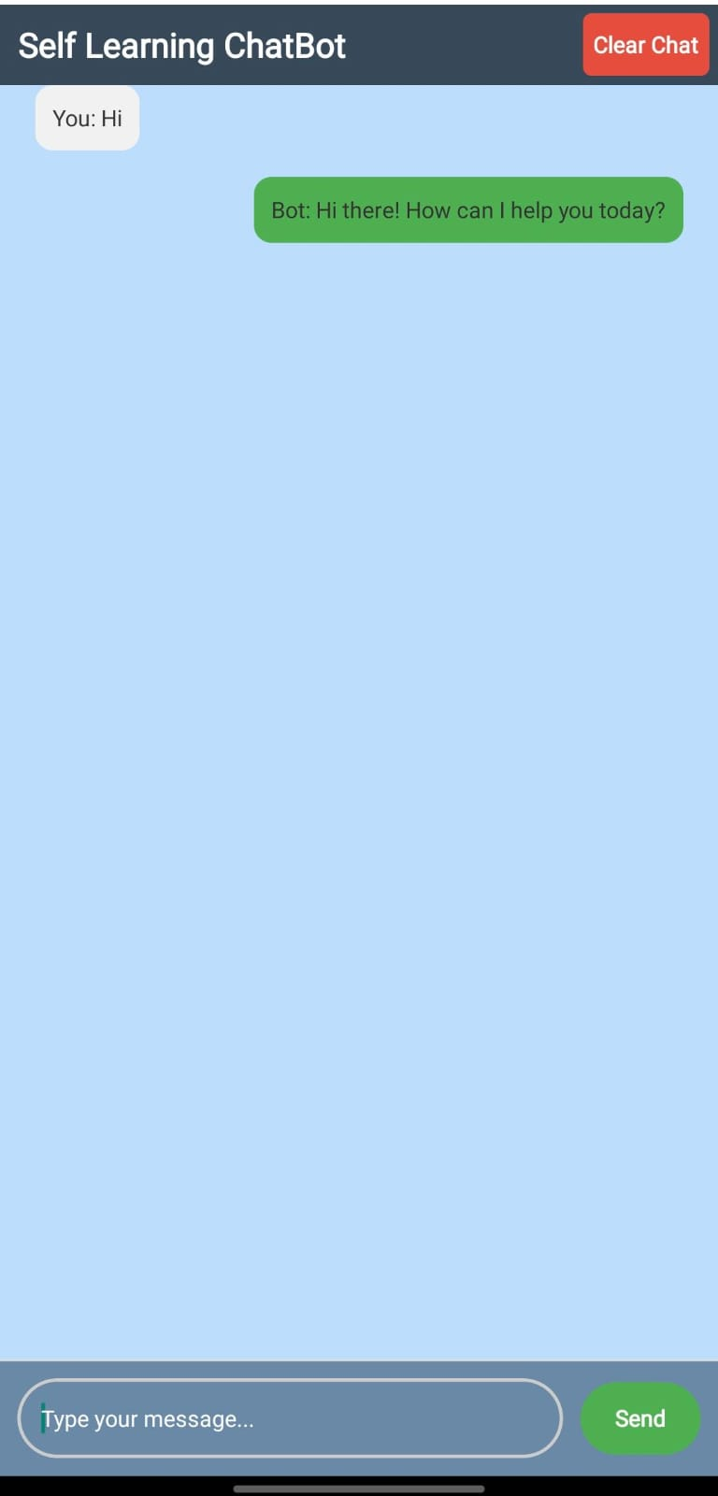
Results / Outcomes obtained (continued…)

Slide 25
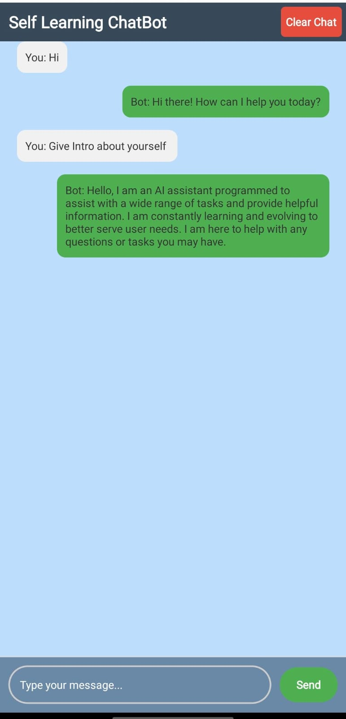
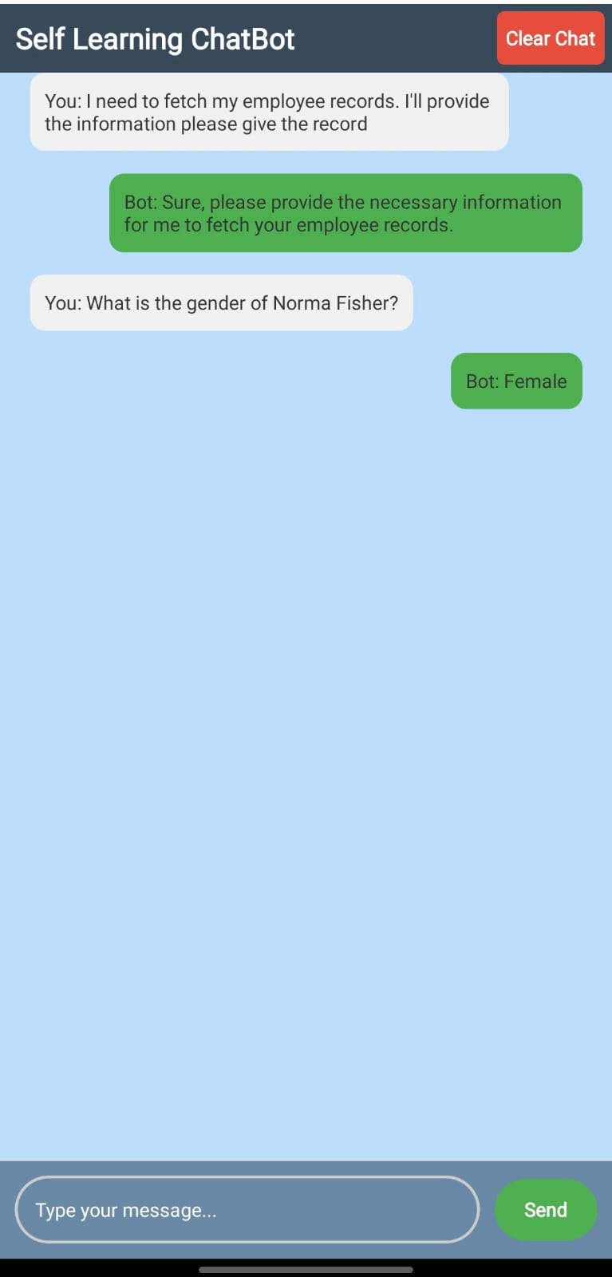
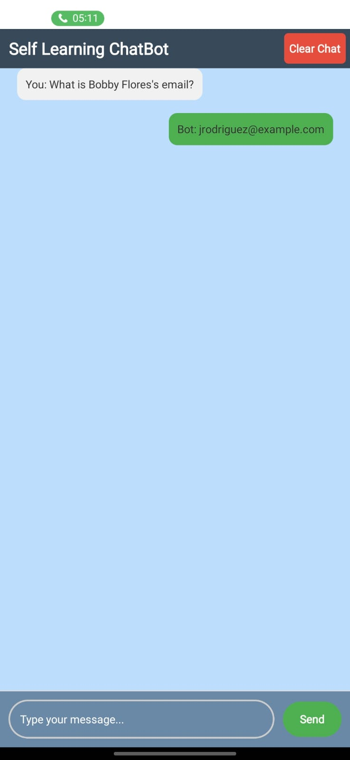
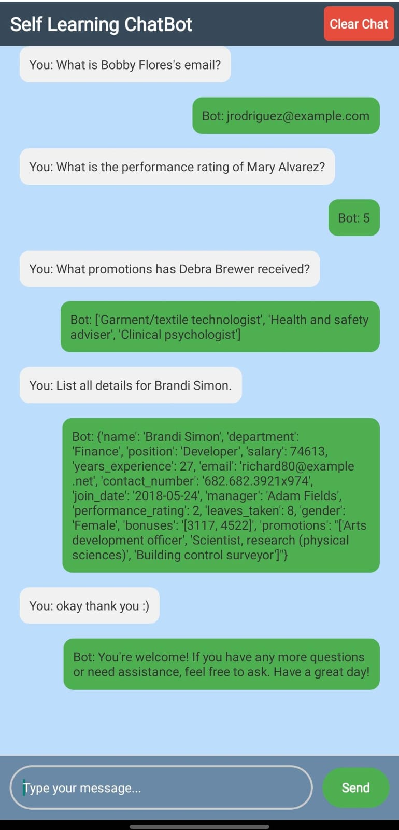
Results / Outcomes obtained (continued…)

Slide 26
Conclusion
The AI-driven chatbot has effectively addressed the inefficiencies of traditional employee management systems by automating the retrieval, updating, and management of employee records through a conversational interface. By leveraging advanced Natural Language Processing (NLP) and machine learning techniques, the chatbot delivers real-time, personalized responses to employee queries, significantly reducing response times and manual errors. Its seamless integration with secure databases ensures that sensitive data is managed responsibly, adhering to compliance standards like GDPR. The chatbot has also minimized reliance on HR teams by enabling a self-service model, allowing employees to independently access critical information. Furthermore, its scalable and adaptable architecture positions it as a versatile solution for industries beyond HR, such as healthcare and finance. This project demonstrates the potential of AI-powered solutions in transforming organizational efficiency while paving the way for future advancements like predictive analytics and enhanced HR functionalities.

Slide 27
Github-Link
Git-hub Link
https://github.com/ayeshakhanum24/self_learning-chatbot

Slide 28
References
https://www.researchgate.net/publication/351228837_Design_and_Development_of_CHATBOT_A_Review
https://www.researchgate.net/publication/367369151_Chatbots_Development_Using_Natural_Language_Processing_A_Review
https://www.researchgate.net/publication/365049624_Live_support_by_chatbots_wit_h_artificial_intelligence_A_future_research_agenda
https://www.researchgate.net/publication/365049624_Live_support_by_chatbots_with_artificial_intelligence_A_future_research_agenda
https://www.mdpi.com/1424-8220/21/24/8448
https://www.technologyreview.com/2023/04/03/1070893/three-ways-ai-chatbots-are-a-security-disaster
https://www.researchgate.net/publication/342842655_The_Impact_of_Chatbots_on_Customer_Service_Performance
https://www.sciencedirect.com/science/article/pii/S1877050921013417
https://www.researchgate.net/publication/365419934_Artificial_intelligence_for_the_improvement_of_records_management_activities_at_the_Council_for_Scientific_and_Industrial_Research
https://www.mdpi.com/2071-1050/15/5/4012

Slide 29
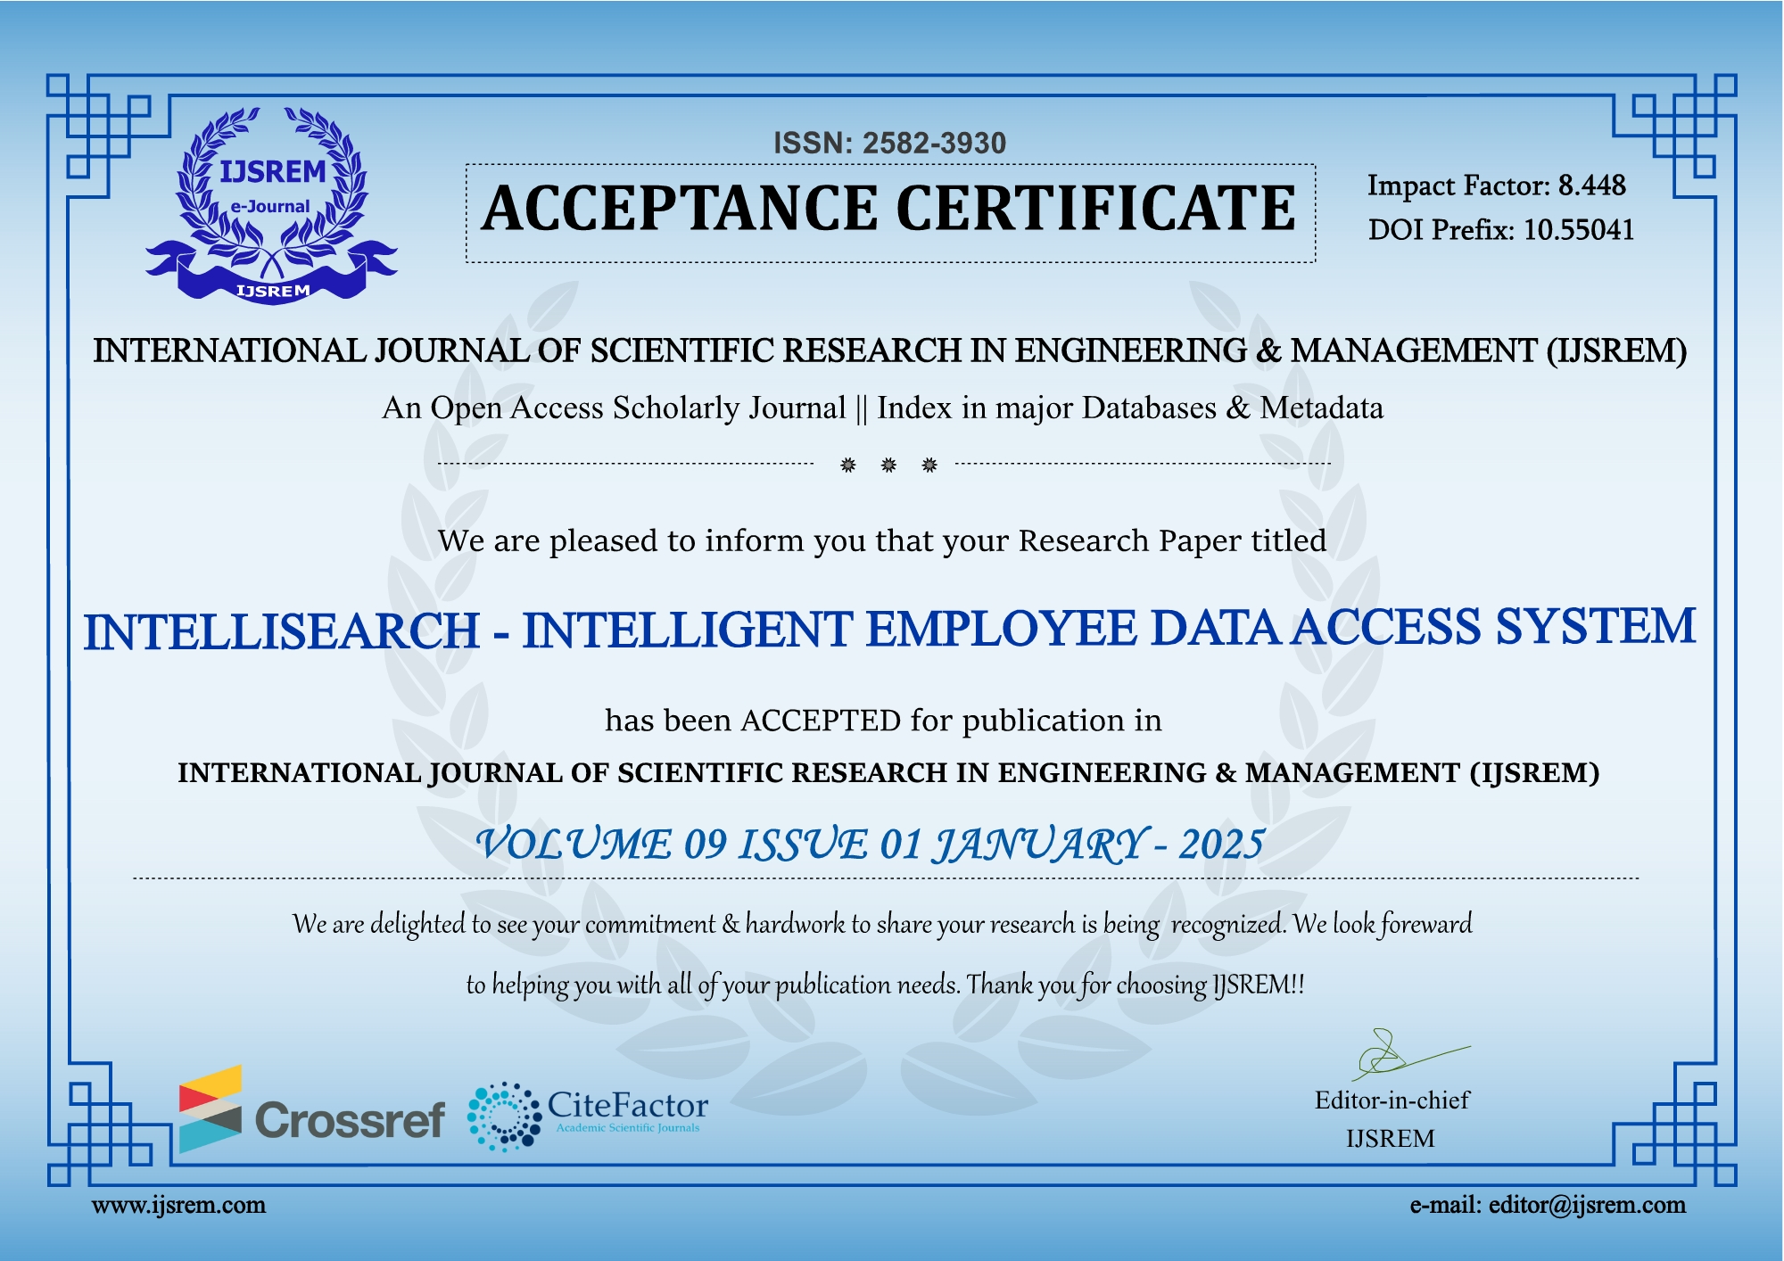
Publlication details.

Slide 30

SDG
The project is mapped to SDG-4 Quality Education and SDG-9 Industry, Innovation, and Infrastructure. The self-learning bot supports SDG-4 by improving education through personalized, adaptive responses for all learners. It also aligns with SDG-9 by using AI to drive innovation and build efficient digital infrastructure. This fosters better access to education and enhances industry development through advanced technology.

Slide 31


